Slide 1

Introduction to
Web Development
Mentor
Gagan Sharma
Education Outreach 2
Organised by: Girlscript

Slide 2
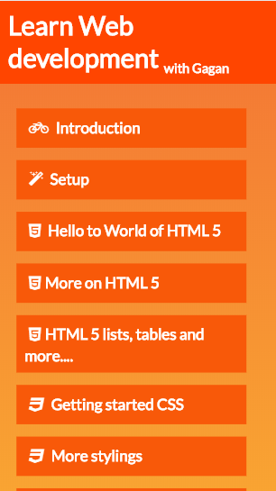
The Course outline
The complete course outline is available at:
webdevwithgagan.orgfree.com/

Slide 3

World of Web!
Web is present,
Web is future.

Slide 4




Don’t stop at websites,
because web doesn’t either.

Slide 5











We use web

Slide 6

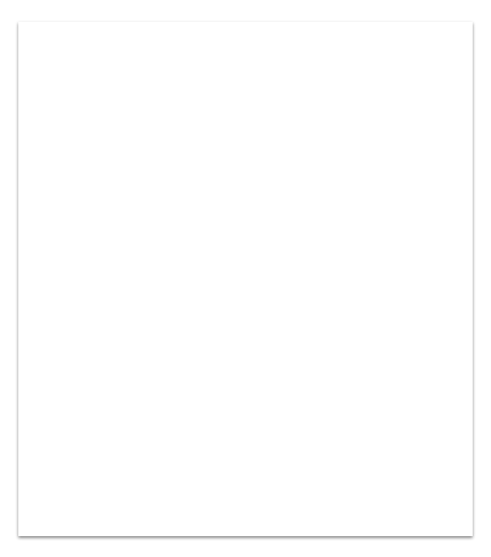
This Course
A basic website uses mainly 3 technologies.
HTML Create basic structure of your website
CSS Add stylings.
Javascript Add interactivity to your website.

Slide 7




Contact me:
t.me/GaganSharma3103
gagan3103sharma2000@gmail.com
linkedin.com/in/gagan-sharma3103

Slide 8


Setup

Slide 9
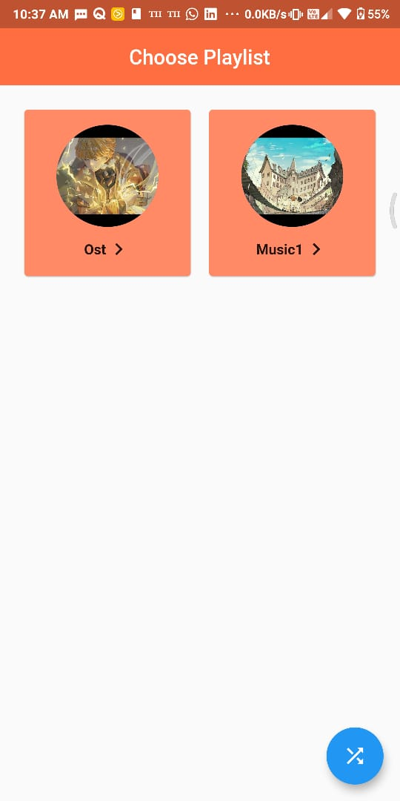
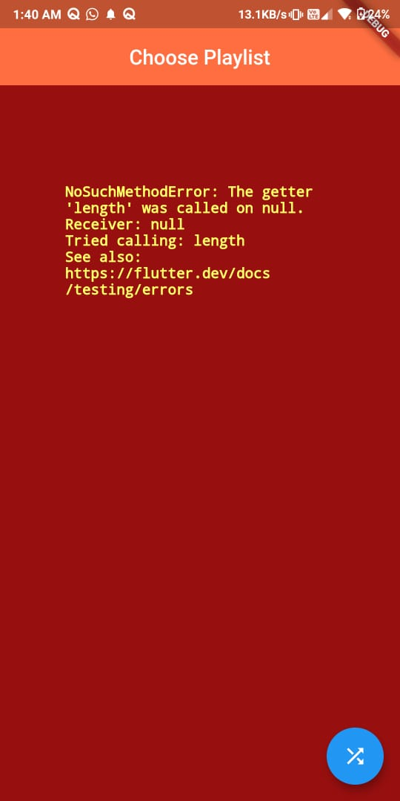

The story
of Amuzic

Slide 10
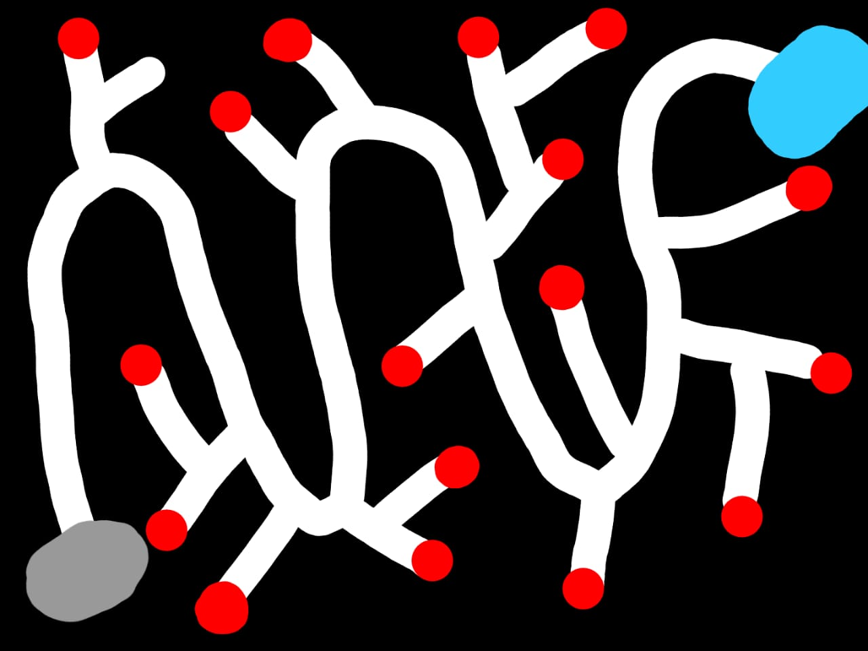
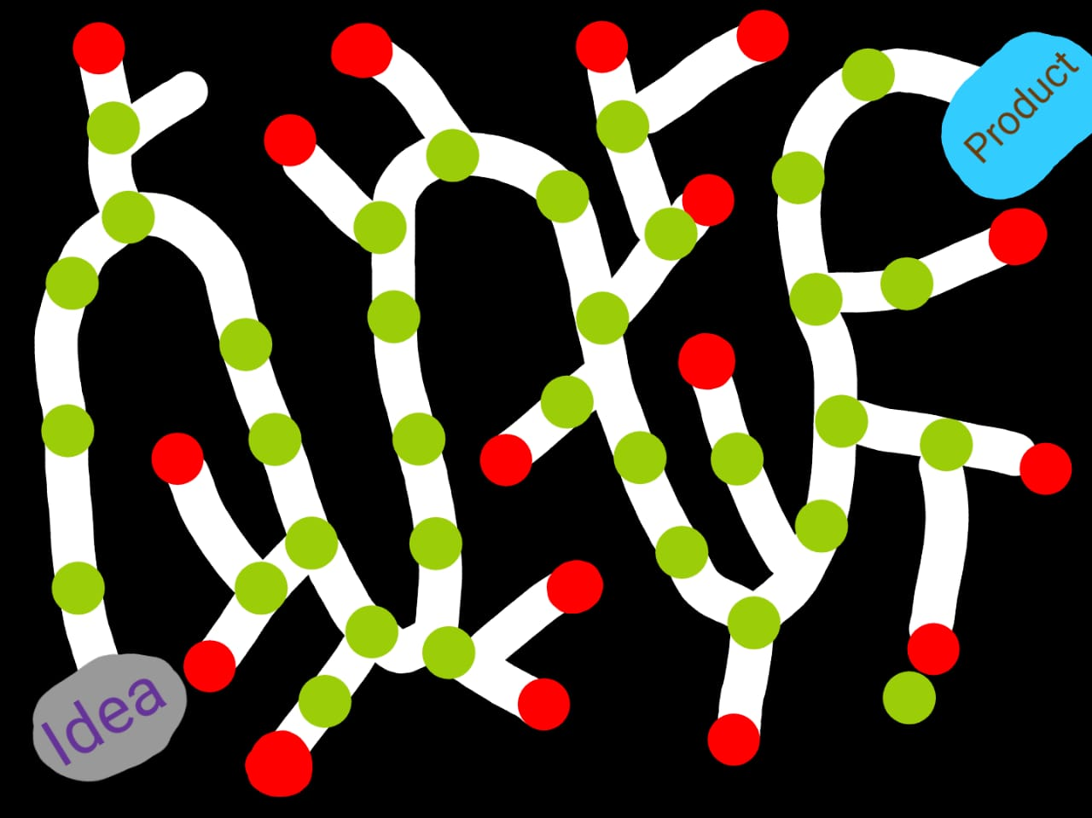
Git saves developers

Slide 11

Webpage
A webpage ia an HTML file that runs on a browser

Slide 12
HTML
What actually is HTML?
Hyper Text Markup Language
Let’s head to html.com for more info

Slide 13
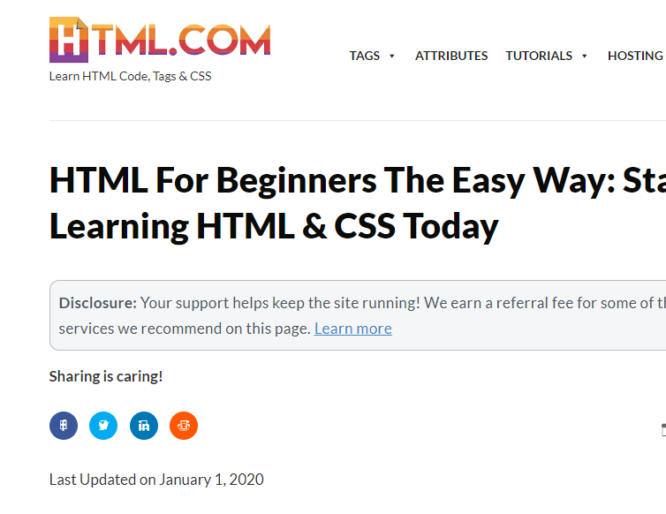
HTML.com
Link
Image
The language which tells browser which part of webpage has what role is HTML
Heading
Box
Buttons

Slide 14

Tags
HTML does it’s job using tags. Just like tags on products in market, an HTML tag has no meaning of it’s own, it only exists to give information about something else.
To differentiate tags with HyperText we use <>.
Ex. <head>,<p>

Slide 15
</> Types of Tags
Closing tags:
They have an opening and closing, they define properties of data present between opening and closing.
Ex <p>birds are cool</p>
Non-closing tags:
They are standalone tags that are not need to be closed.
Ex <br>

Slide 16
Hello to World of HTML 5
HTML
Head
Tags:
It’s all about tags.
<HTML></HTML>
<IMG/>
<TABLE>
Body

Slide 17
Let’s jump into VSCode
and
start developing.

Slide 18
Basic HTML tags
<!DOCTYPE>
<HTML></HTML>
<HEAD></HEAD>
<TITLE></TITLE>
<BODY></BODY>
<H1>………<H6>
<P></P>
<BR>
<HR>

Slide 19
Let’s jump into VSCode
and
start developing.

Slide 20
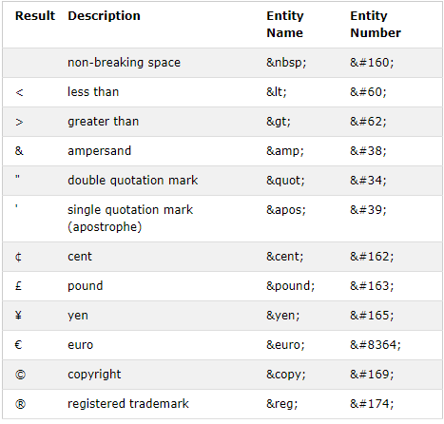
Comments
White Spaces
HTML ignores enters and multiple spaces.
Because developers work together :)
Nesting Elements
Elements inside elements

Slide 21
Let’s jump into VSCode
and
start developing.

Slide 22
Text formatting tags
Bold
Italic
Deleted
Marked
Subscript
Superscript
Code
Underline

Slide 23
Let’s jump into VSCode
and
start developing.

Slide 24
Some other tags
Spans
Div
Buttons
Cite
Blockquote

Slide 25
Let’s jump into VSCode
and
start developing.

Slide 26
Attributes
Attributes are properties of an element each tag has it’s own special set of attributes, you can also define custom attributes for your tags
<html lang=“en-US”></html>
<p title=“this has a title”></p>

Slide 27
Let’s jump into VSCode
and
start developing.

Slide 28
IDs and Classes
The id attribute specifies a unique id for an HTML element
<p id=”turtle”></p>
The class attribute specifies a group an HTML element belongs to.
<p class=“reptile”></p>

Slide 29
Let’s jump into VSCode
and
start developing.

Slide 30
Links
Anchor tag:
<a>
Attributes:
Href= url, id, mailto:, tel:
target =_blank,_parent,_self,_top, framename
download

Slide 31
Let’s jump into VSCode
and
start developing.

Slide 32
Images
Image tag:
<img>
Attributes:
Src
Height, width
Alt

Slide 33
Let’s jump into VSCode
and
start developing.

Slide 34
Block tags
These tags are basically div tags specialized for one purpose.
Section
Header
Footer
Main
Article
Summary

Slide 35
Let’s jump into VSCode
and
start developing.

Slide 36
Lists
Creates a list of hypertext, there are 3 types of lists
Ordered list
Unordered list
Description list

Slide 37
Ordered list
This tag created a numbered/ordered list.
<ol>
<li>first</li>
<li>second</li>
<li>third</li>
<li>fourth</li>
</ol>
Attributes:
Start=number
reversed
Type= 1, a, A, I, i

Slide 38
Let’s jump into VSCode
and
start developing.

Slide 39
Unordered list
This tag created a numbered/ordered list.
<ul>
<li>first</li>
<li>second</li>
<li>third</li>
<li>fourth</li>
</ul>

Slide 40
Let’s jump into VSCode
and
start developing.

Slide 41
Description list
This tag creates a list of term definition pair.
<dl> <dt>Birds</dt> <dd>Pretty animals</dd> <dt>Turtle</dt> <dd>cute ☺ </dd> </dl>

Slide 42
Let’s jump into VSCode
and
start developing.

Slide 43
Tables
Tags:
caption
tbody
tr
td
thead
th
tfoot
This tag creates an HTML table.
<table> <thead> <th>Pet</th> <th>Score</th> </thead> <tr> <td>Bird</td> <td>100</td> </tr> </table>

Slide 44
Let’s jump into VSCode
and
start developing.

Slide 45
Form
This tag creates an HTML table.
<form> <label for=“pet">Pet:</label> <input type="text" id=“pet" name=“pet"><br><br> <label for=“name">Name:</label> <input type="text" id="name" name="name"><br><br> <input type="submit" value="Submit"> </form>
Attributes:
Name= text
Accept-charset= character_set
Name = ‘Text’

Slide 46
Form tags
Input:
TextArea:
Multi line text input
Select:
selection in options
options:
select options
Label:
label for elements
Buttons
Attributes:
Type=
Button
checkbox
Date
Email
file
Number
Password
Radio
Range
Reset
Search
Submit
Tel
text
Value= default
Name = ‘text’
Required

Slide 47
Let’s jump into VSCode
and
start developing.

Slide 48
Videos and audios
Adds video/audio to page.
<video > <source src=“duckTales.mp4"
type="video/mp4"> <source src=“duckTales.ogg“
type="video/ogg"> Your browser does not support the video tag. </video>
Attributes:
Controls
Muted
Poster=‘imageURL’
Loop
Autoplay

Slide 49
Let’s jump into VSCode
and
start developing.

Slide 50
iFrames
iFrame lets you insert a page within a page.
<iframe src=“http://webdevwithgagan.orgfree.com/”>
</iframe>
Attributes:
Allowfullscreen=true/false
Allowpaymentrequest
SRC

Slide 51
Let’s jump into VSCode
and
start developing.

Slide 52
Introduction to Web Development
Doubt break
Please go through everything taught today and let me if any part is unclear we will continue tomorrow by then practice whatever you have learnt, contact me if any problem arises.
Organised by: Girlscript
Mentor: Gagan Sharma

Slide 53

Class end
Practice everything you learned today, share your doubts and projects on the slack channel.

